Slide 1
GO Language

Slide 2
Features
Support for environment adopting patterns similar to dynamic languages. For example, type inference (x := 0 is valid declaration of a variable x of type int)
Compilation time is fast.
Inbuilt concurrency support: lightweight processes (via go routines), channels, select statement.
Go programs are simple, concise, and safe.
Support for Interfaces and Type embedding.
Production of statically linked native binaries without external dependencies.
Go is a case-sensitive programming language.

Slide 3
First program
package main
import "fmt"
func main() {
fmt.Println("Hello, World!")
}

Slide 4
Packages
fmt stands for the Format package. This package allows to format basic strings, values, or anything and print them or collect user input from the console, or write into a file using a writer or even print customized fancy error messages. This package is all about formatting input and output.
https://yourbasic.org/golang/fmt-printf-reference-cheat-sheet/#printf
https://gobyexample.com/

Slide 5
Steps in execution
Open a text editor and add the above-mentioned code.
Save the file as hello.go
Open the command prompt.
Go to the directory where you saved the file.
Type go run hello.go and press enter to run your code.

Slide 6
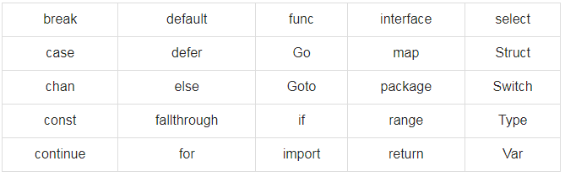
Keywords

Slide 7
Data type
var i, j, k int;
var c, ch byte;
var f, salary float32;
Example :
package main
import "fmt"
func main() {
var x float64
x = 20.0
fmt.Println(x)
fmt.Printf("x is of type %T\n", x)
}

Slide 8
Program
package main
import "fmt"
func main() {
const conferenceTickets int = 50
var remainingTickets uint = 50
conferenceName := "Go Conference"
fmt.Printf("Welcome to %v booking application.\nWe have total of %v tickets and %v are still available.\nGet your tickets here to attend\n", conferenceName, conferenceTickets, remainingTickets)

Slide 9
var firstName string
var lastName string
var email string var userTickets uint
// asking for user input
fmt.Println("Enter Your First Name: ")
fmt.Scanln(&firstName)
fmt.Println("Enter Your Last Name: ")
fmt.Scanln(&lastName)
fmt.Println("Enter Your Email: ")
fmt.Scanln(&email)
fmt.Println("Enter number of tickets: ")
fmt.Scanln(&userTickets)

Slide 10
// book ticket in system
remainingTickets = remainingTickets – userTickets
fmt.Printf("Thank you %v %v for booking %v tickets. You will receive a confirmation email at %v\n", firstName, lastName, userTickets, email) fmt.Printf("%v tickets remaining for %v\n", remainingTickets, conferenceName)
}

Slide 11
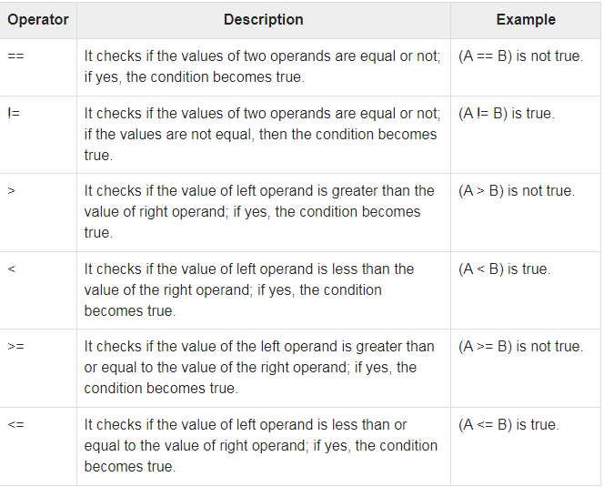
OPERATORS

Slide 12
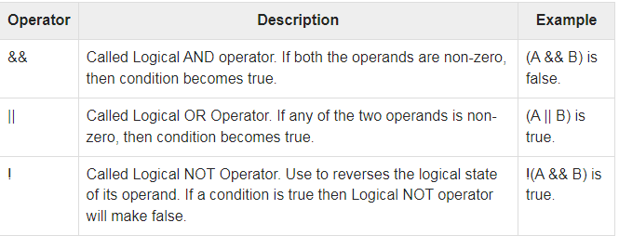
Logical operator

Slide 13
Conditional Statements and loops
package main
import "fmt"
func main() {
if 7%2 == 0 {
fmt.Println("7 is even")
} else {
fmt.Println("7 is odd")
}
for j := 7; j <= 9; j++ {
fmt.Println(j)
}
}

Slide 14
Switch case
import (
"fmt"
)
func main() {
i := 2
fmt.Print("Write ", i, " as ")
switch i {
case 1:
fmt.Println("one")
case 2:
fmt.Println("two")
case 3:
fmt.Println("three")
}
}

